Slide 1
Size of Cells

Slide 2
In this Smart Lesson, we will be:
Clarifying the size of cells.
Describe the size of viruses.
Defining the units of measurement we usually use to measure cells and viruses.

Slide 3
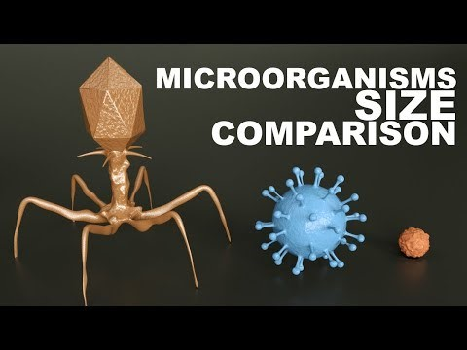

Slide 4

Believe it or not, there are things even smaller than most cells!
Have you ever wondered what causes you to come down with a cold or flu?
Extremely small microbes called viruses invade the cells in your body, making you feel sick.

Slide 5
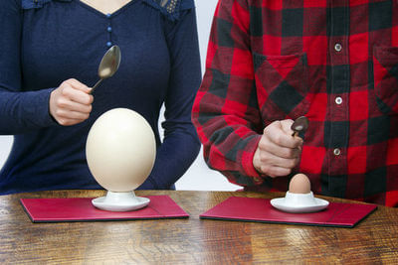
Most cells are microscopic.
There are a few exceptions however.
One of the largest single cells in the world is the ostrich egg, as it can be seen without using a microscope. It is much larger than the cells that make us up!

Slide 6
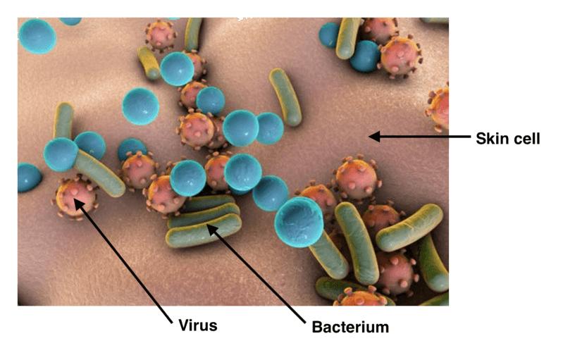
Human cells are so small that they can only be seen by magnifying them with a microscope.
Although human cells must be magnified to be seen, they are still much larger than bacteria, which are smaller, more primitive cells.
Viruses are even smaller, although they aren't technically cells because they aren't alive. Viruses are measured in nanometres.

Slide 7
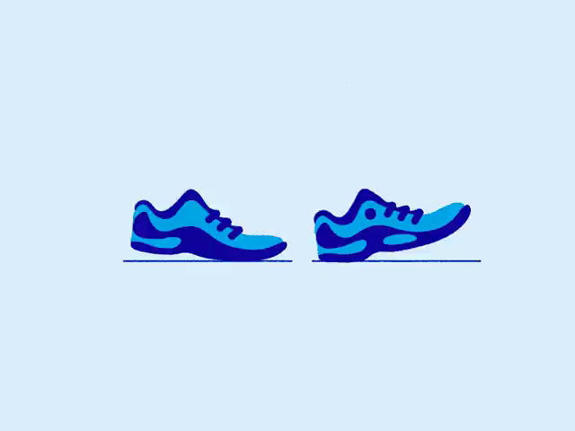
Cells are so small that they are measured in micrometres.
One micrometre is one millionth of a metre.
Stand up and take one very large step. Your step will be about the same length as one metre. Imagine how small an object must be to fit one million of them between your two feet!
1 micrometre =1 μm=1×10⁻⁶ m
1,000,000 (one million) micrometres fit into 1 metre.

Slide 8
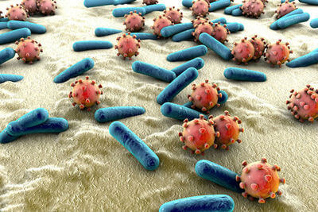
In order to break into our cells, viruses must be much smaller than them!
In fact, they are so small, that they are measured using nanometres. One nanometre is 1000 times smaller than one micrometre.
In other words, one nanometre is one billionth of a metre!
1 nanometre =1 nm=1×10⁻⁹ m
1,000,000,000 (one billion) nanometres fit into 1 metre

